Slide 1
Movie Recommendation System - Collaborative Filtering
By Jing Kunzler for LaiData

Slide 2
The Dataset
Last updated 9/2018.
In this recommendation system, we used only movies and ratings table.
610 users
all users in this data have rated at least one movie
100836 ratings
All explicit ratings
9742 movies
18 movies have not been rated
6456 movies have been rated by less than 5 users
https://grouplens.org/datasets/movielens/latest/)

Slide 3
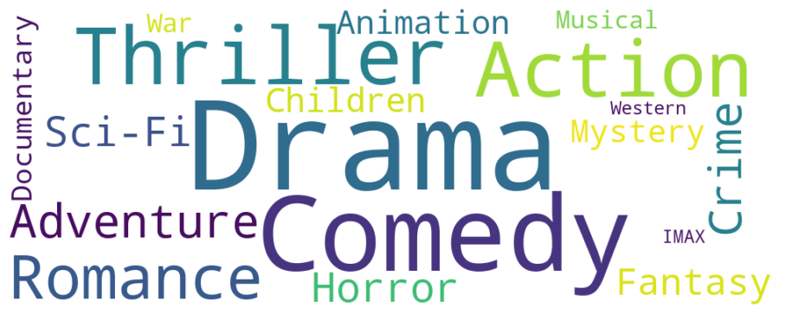
Data Highlights

Slide 4
Goals:
Recommends movies to a user with what similar users rated
Recommend similar movies by genre for cold start problem

Slide 5
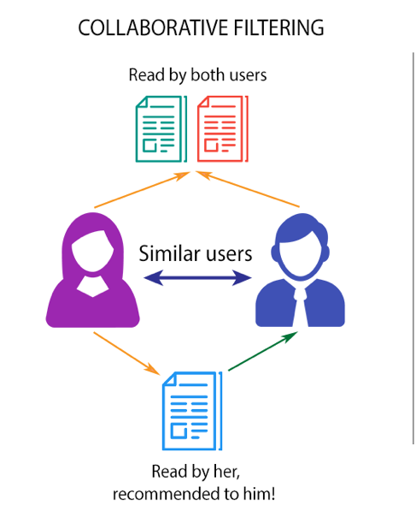
Collaborative Filtering & ALS
Collaborative filtering aggregates the past behaviour of all users. It recommends items to a user based on the items rated by another similar set of users’ rating behavior.
Defactorization of a large sparse matrix
No domain knowledge of user/item features required
Can help users discover new interests
A great starting point

Slide 6
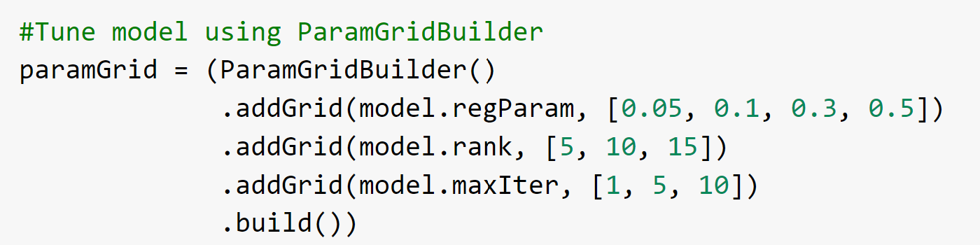
Training
80 % rating data
Tuning
5-fold cross validation
RMSE as evaluator

Slide 7
Validation
20 % rating data
Best model: Rank = 15, Iteration = 10, regParam = 0.01
RMSE ≈ 0.61
Making predictions on ratings

Slide 8
Application to a random user
Create a dataset the specified user and all the movies listed in the ratings
Collect movies historically rated by this user
Predict ratings of the movies such user has not rated
Get the movie titles from these recommendations
Display results

Slide 9
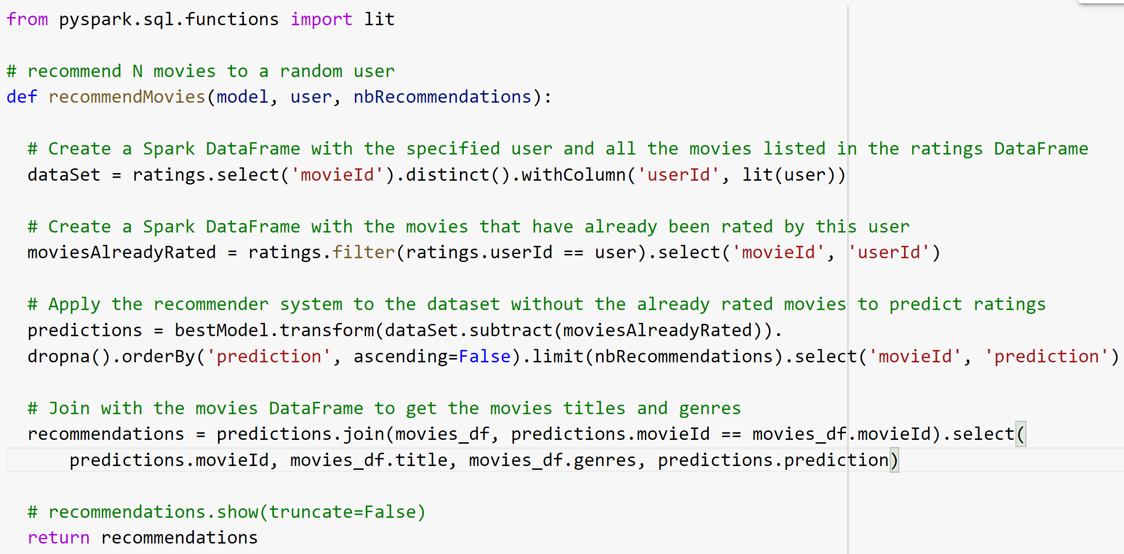

Slide 10
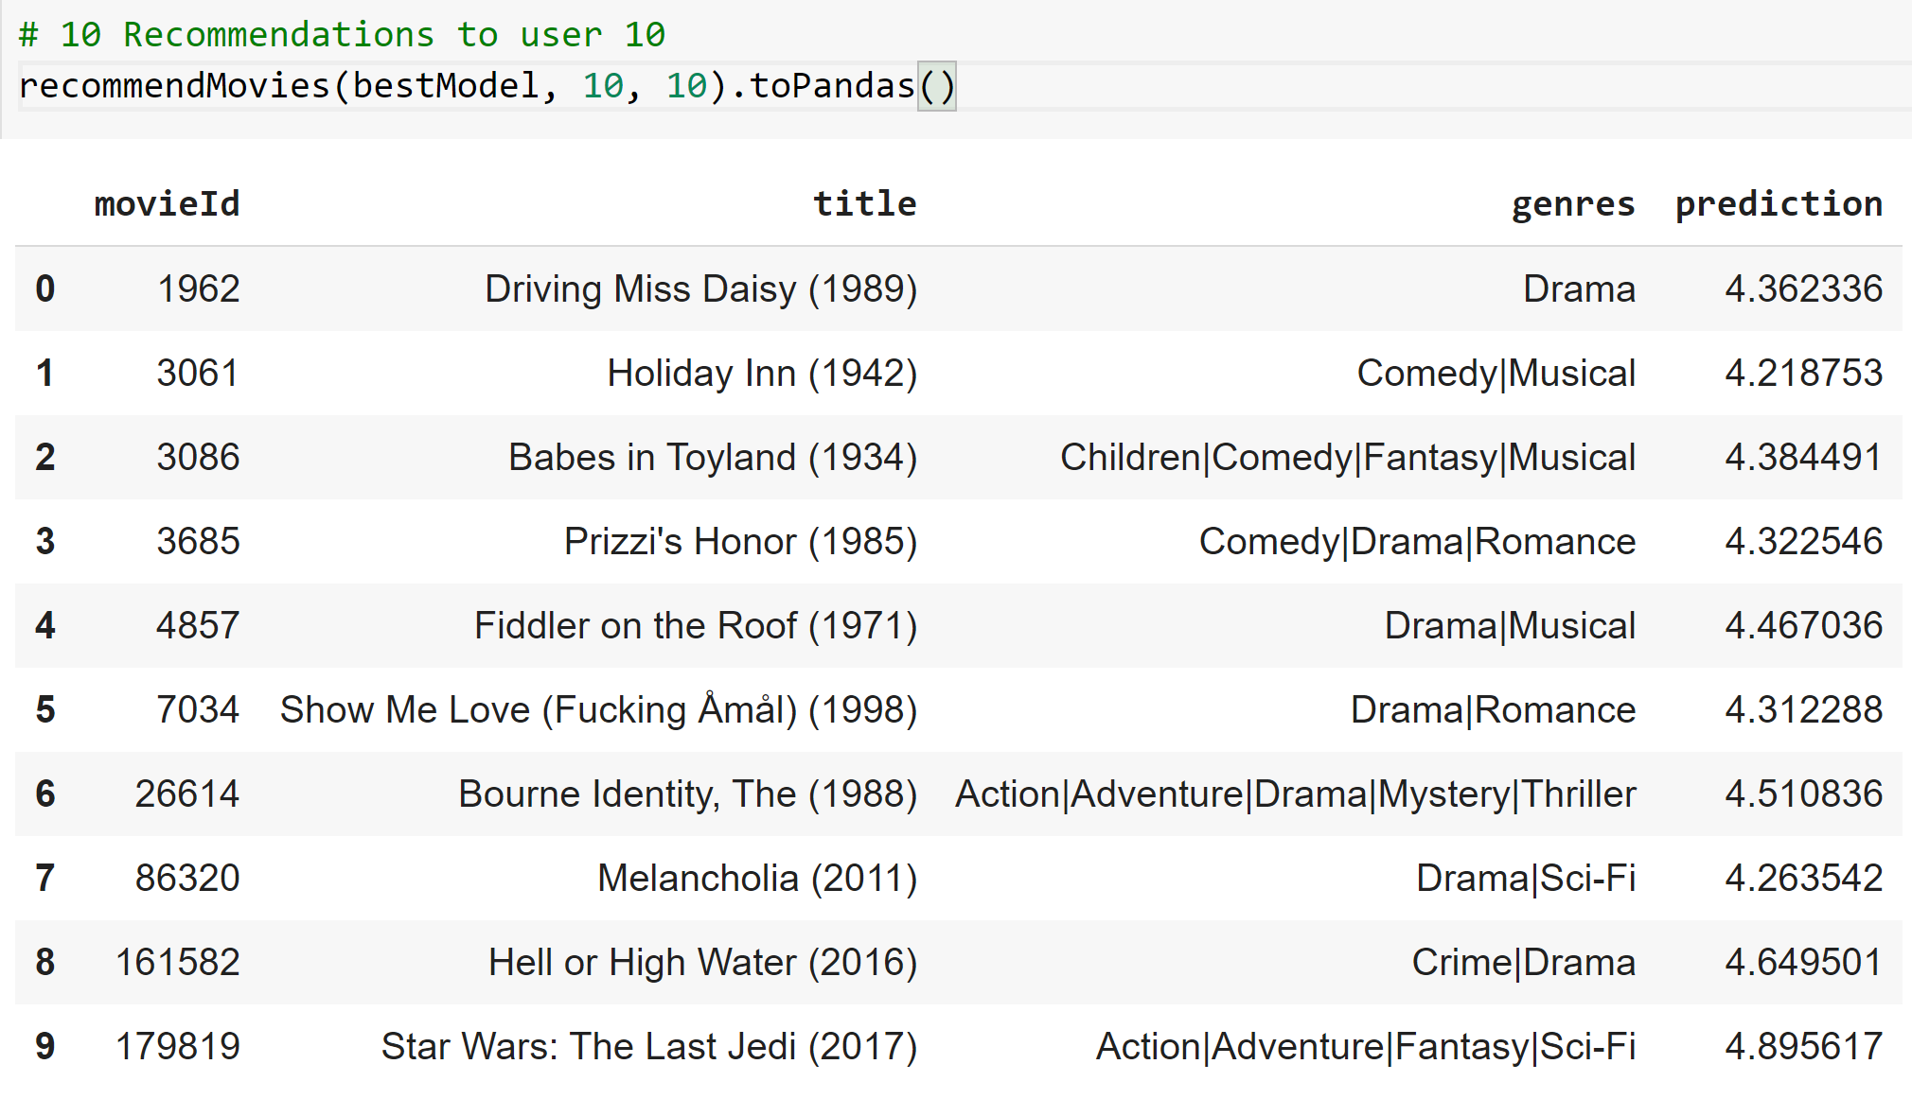

Slide 11
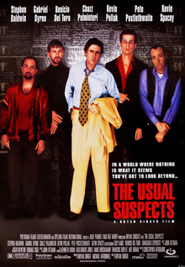
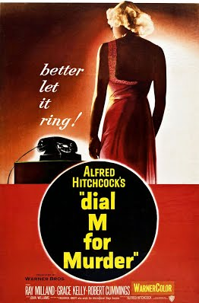
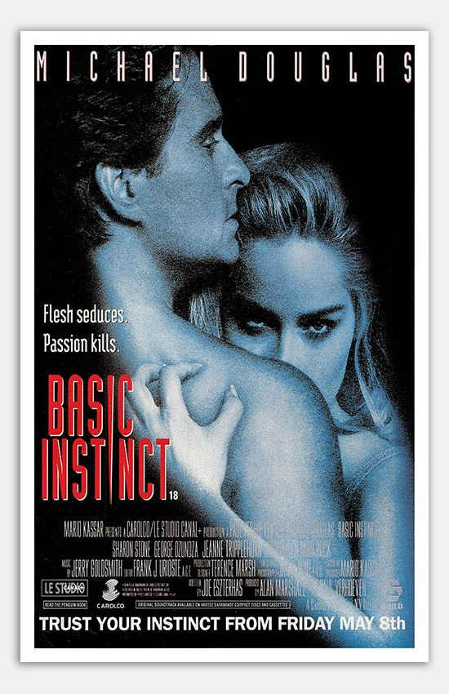

If you liked The Usual Suspects (1995), you may also like:
---------------------->

Slide 12
“If you watched…, you may also watch…” based on genre
In this scenario, a user who liked a thriller movie, might like another thriller movie. Genre is the sole feature, converted to a matrix using TF-IDF, and then the feature matrix was used to calculate pairwise cosine similarity.
Three steps:
TF-IDF for a matrix of genres
Cosine similarity of genres
Sort movies based on cosine similarity and recommend top 10 similar movies

Slide 13
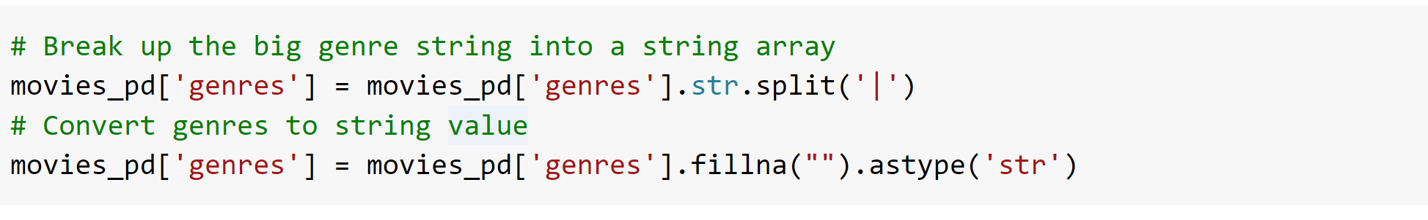
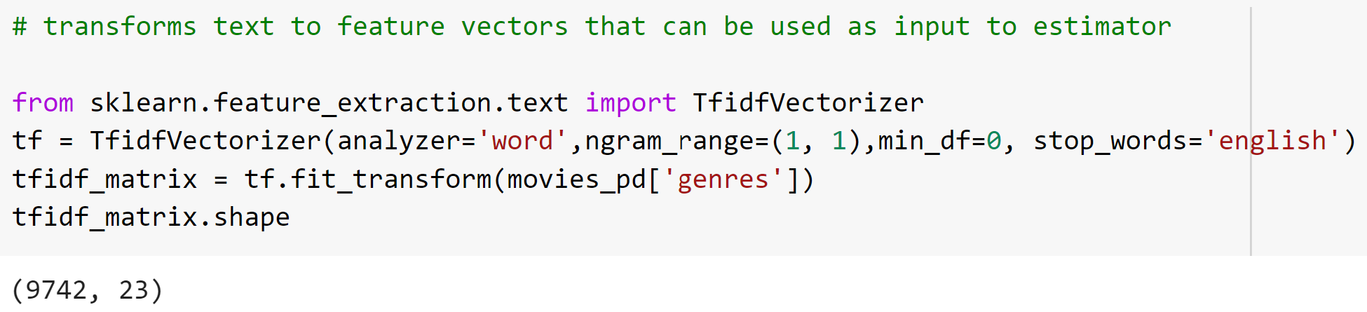
TF-IDF

Slide 14
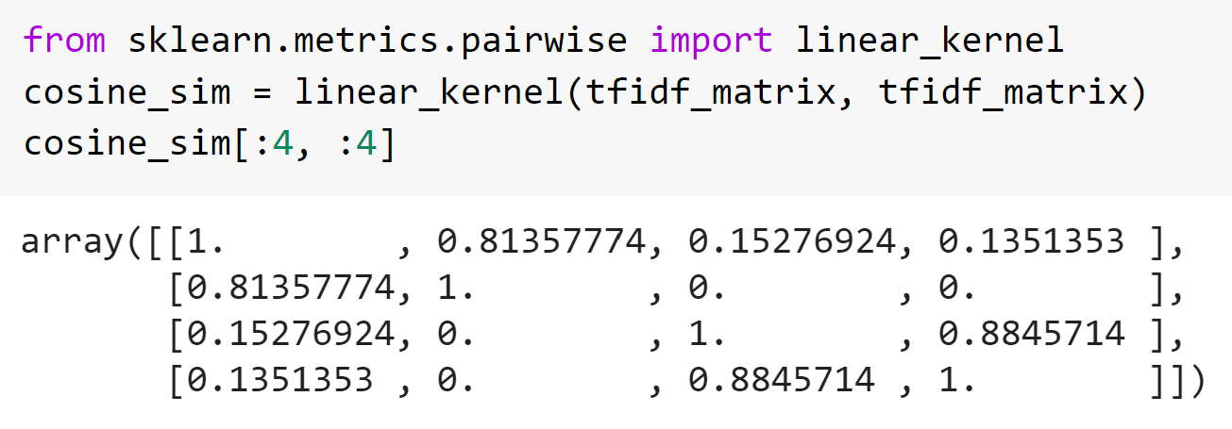
Cosine Similarity of genres

Slide 15
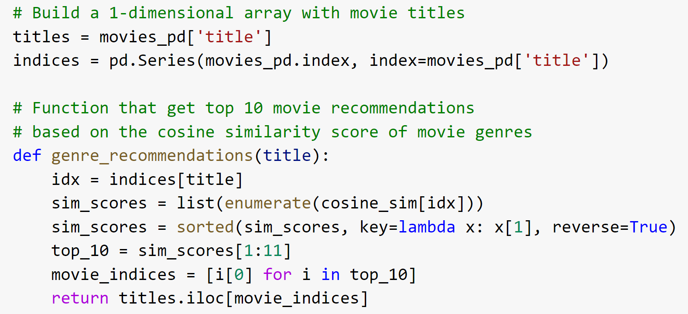
Recommend 10 similar movies

Slide 16
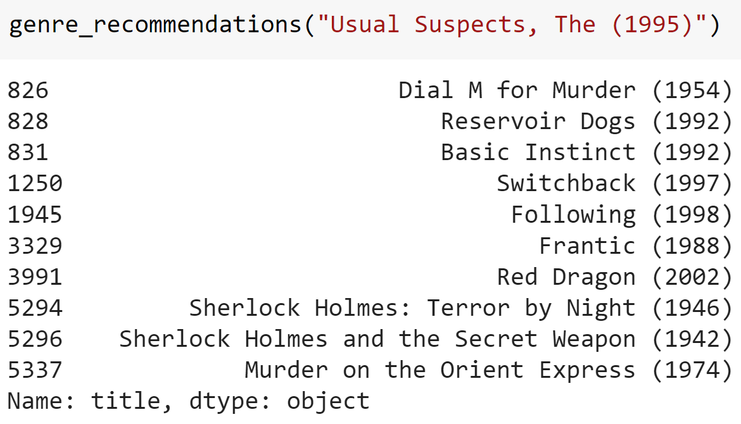

Slide 17
Discussion
Cold start problem?
New user
New movie / unrated movie
Messy title format.
E.g. : “Usual Suspects, The (1995)” - the year & order of “The”
Computation limit
Potential insights to use from tag information
Alternative methods

